Slide 1

KALERWE
S.D.A Hymnal 15
4~ Verses
9.
Ggwe Eyanunula…
~
My Maker and My King…

Slide 2

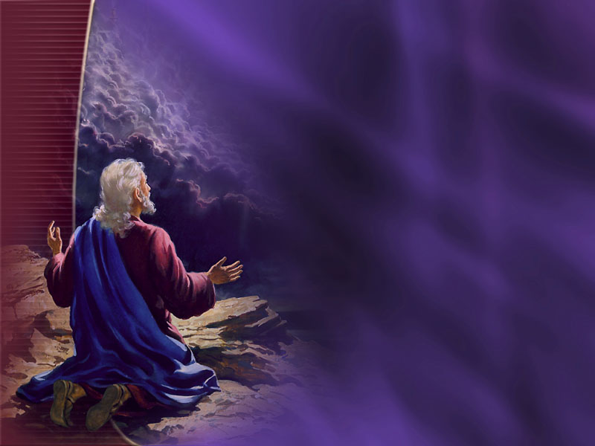
1 of 4 verses
Ggwe eyanunula nebaza (e)kisa kyo,
Mu Ggwe mwe muli (e)nsibuko
y’emikisa gyonna,
Mu Ggwe mwe muli (e)nsibuko
y’emikisa gyonna,

Slide 3
2 of 4 verses
Nze ndi kitonde kyo Ggwe (o)bulamu bwange,
Katonda wange, nsanidde okukusutanga
Katonda wange, nsanidde okukusutanga,

Slide 4
3 of 4 verses
Kale nakuwa ki anti byonna bibyo?
Mpayo omutima gwange, sadaaka y’omwavu,
Mpayo omutima gwange, sadaaka y’omwavu,

Slide 5
4 of 4 verses
Nsaba ekisa kyo, kinjijuze (a)maanyi
Okwagala kwange kwonna kubeerenga kukwo,
Okwagala kwange kwonna kubeerenga kukwo,

